Slide 1


모두의 딥러닝 6강
Softmax Classification

Slide 2




CONTENTS
1
2
Softmax
Cross Entropy

Slide 3




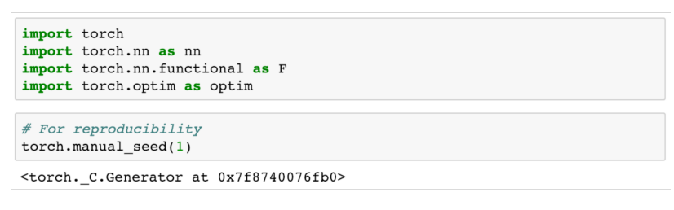







Import

Slide 4





1
Softmax

Slide 5
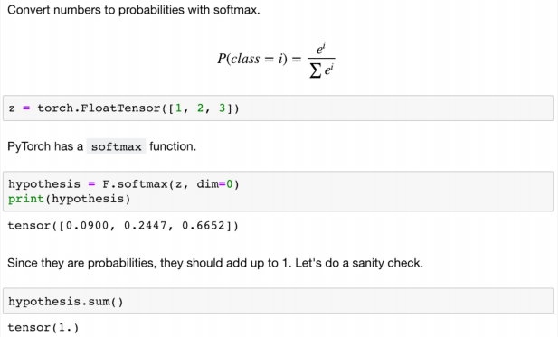
1
Softmax

Slide 6
1
Softmax

Slide 7


1
Softmax

Slide 8





1
Softmax

Slide 9



1
Softmax

Slide 10
2
Cross Entropy

Slide 11








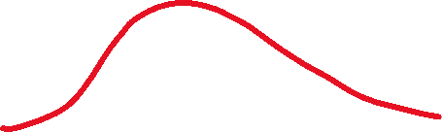

2
Cross Entropy

Slide 12
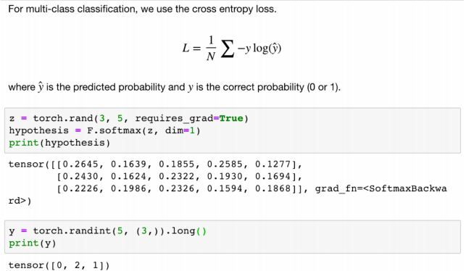


2
Cross Entropy

Slide 13




2
Cross Entropy

Slide 14
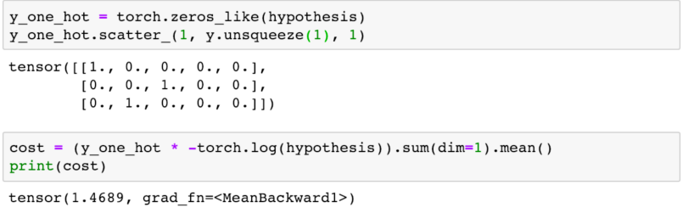





2
Cross Entropy

Slide 15
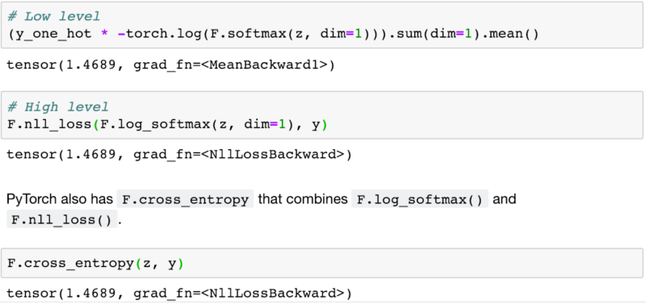

2
Cross Entropy

Slide 16
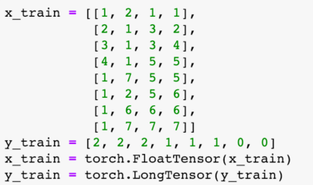


2
Cross Entropy

Slide 17
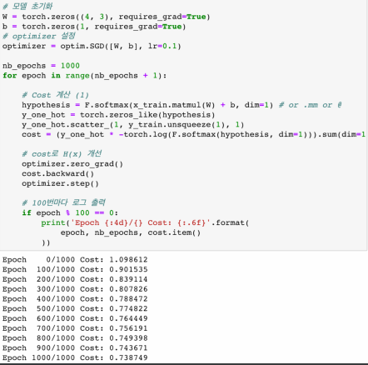

2
Cross Entropy

Slide 18
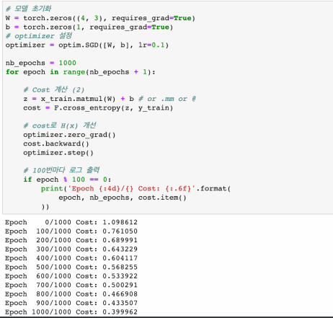



2
Cross Entropy

Slide 19
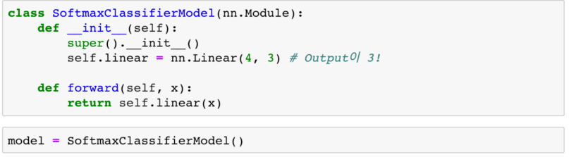

2
Cross Entropy

Slide 20
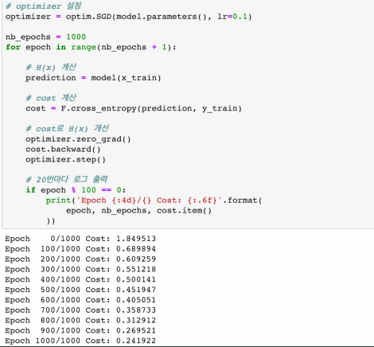
2
Cross Entropy

Slide 21

“THANK YOU FOR WATCHING”

